Slide 1
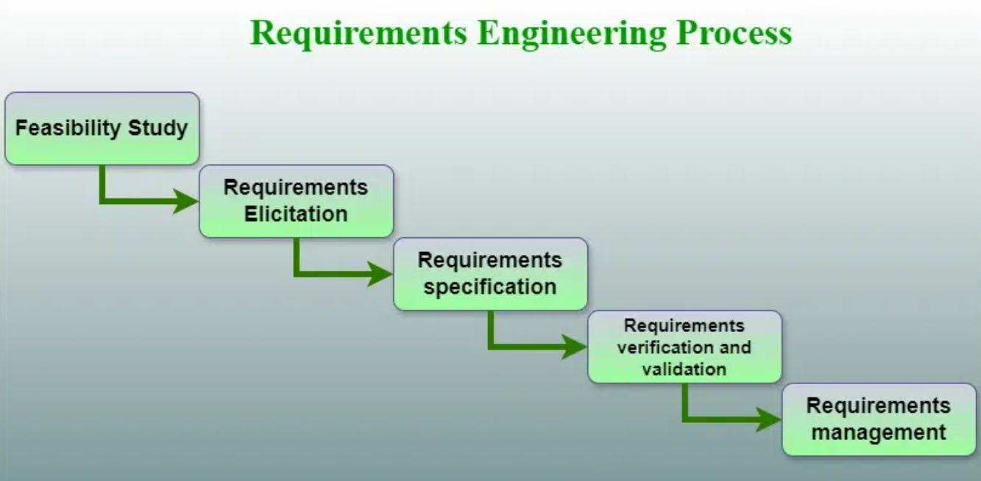
Software Requirements

Slide 2
Software Requirements
It is the description of features and functionalities of the target system.
It is the description of what the system should do.
Requirements Engineering (RE) refers to the process of defining, documenting, and maintaining requirements in the engineering design process.
It is a four-step process, which includes:
Feasibility Study
Requirements Gathering/Elicitation
Software Requirements Specification
Software Requirements Validation
Software Requirements Management

Slide 3
Techniques for Effective Requirements Engineering
Observation Reports (User Observation):
Observe users in their natural working environment to understand workflows, challenges, and requirements.
Questionnaires:
Gather information using structured interviews, surveys, and polls to collect feedback from stakeholders.
Use Cases:
Describe step-by-step interactions between the user and the system to define specific functionalities and behavior.
User Stories:
Short, simple descriptions of features from the end-user's perspective (e.g., "As a user, I want to search for products so I can find what I need quickly.").
Requirement Workshops:
Collaborative sessions involving stakeholders to brainstorm, discuss, and finalize requirements efficiently.

Slide 4
Techniques for Effective Requirements Engineering
Mind Mapping:
Use visual diagrams to represent and organize requirements, ideas, and relationships clearly and concisely.
Role-Playing:
Simulate user roles and workflows to identify hidden requirements and validate system usability.
Prototyping:
Build visual or functional models of the software to demonstrate features, gather feedback, and refine requirements.

Slide 5
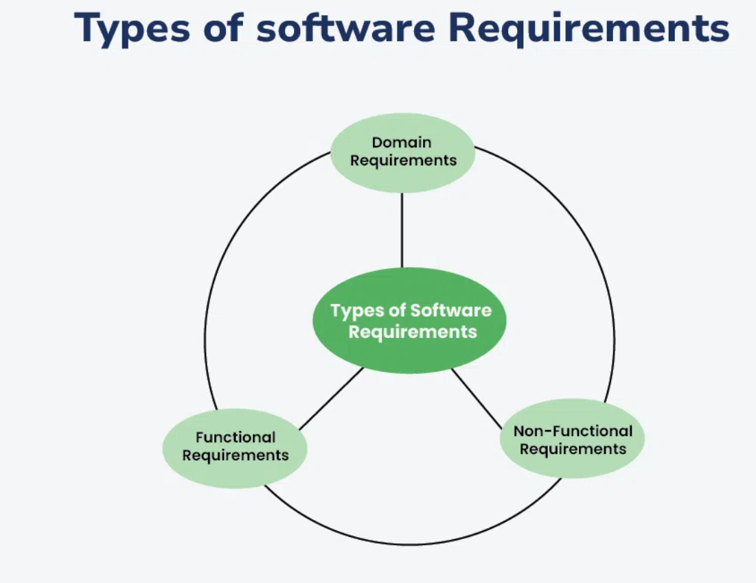
Types of Software Requirements

Slide 6
Functional Requirements
Functional Requirements: These are related to the functional/working aspect of software and define what the system should do. They describe specific features, inputs, outputs, and behavior of the system.
Login Functionality
Search Feature
Order Placement
Report Generation
Email Notifications
User Registration
Payment Processing
Profile Management
File Upload and Download

Slide 7
Non-Functional Requirements
Non-Functional Requirements: Expected characteristics of target software, including:
Security
Storage
Configuration
Performance
Cost
Interoperability
Flexibility
Disaster Recovery
Accessibility

Slide 8
Domain Requirements
Domain requirements are specific to the domain or industry in which the software operates. They include terminology, rules, and standards relevant to that particular domain.
Healthcare: The software must comply with Nepal Health Research Council (NHRC) guidelines and ensure secure handling of patient data as per Nepal's Health Data Privacy Standards.
Finance: The system should adhere to the Nepal Accounting Standards (NAS) for financial reporting and comply with Nepal Rastra Bank (NRB) regulations.
E-commerce: The software should support payment gateways commonly used in Nepal, such as eSewa, Khalti, IME Pay, and bank transfers through local banks.

Slide 9
Software Requirements Specification (SRS)
SRS is a description of a software system to be developed.
It lays out functional, non-functional, and domain requirements of the software to be developed.
It may include a set of use cases that describe user interactions that the software must provide to the user for perfect interaction.

Slide 10
SRS Structure
1. Introduction 1.1 Purpose 1.2 Intended Audience 1.3 Scope 1.4 Definitions 1.5 References
2. Overall Description 2.1 User Interfaces 2.2 System Interfaces 2.3 Constraints, assumptions, and dependencies 2.4 User Characteristics

Slide 11
SRS Structure
3. System Features and Requirements 3.1 Functional Requirements 3.2 Use Cases 3.3 External Interface Requirements 3.4 Logical database requirement 3.5 Nonfunctional Requirements
4. Deliver for Approval

Slide 12
URD/URS
Easy & Simple to Operate
Quick Response
effectively handling operational errors
Customer support
The user requirement(s) document (URD) or user requirement specification (URS) is a document usually used in software engineering that specifies what the user expects the software to be able to do.
It is a contractual agreement.

